Slide 1

PCWG 2015 Roadmap: Detailed Survey Results
PCWG
9th Meeting December 2014 - Glasgow

Slide 2
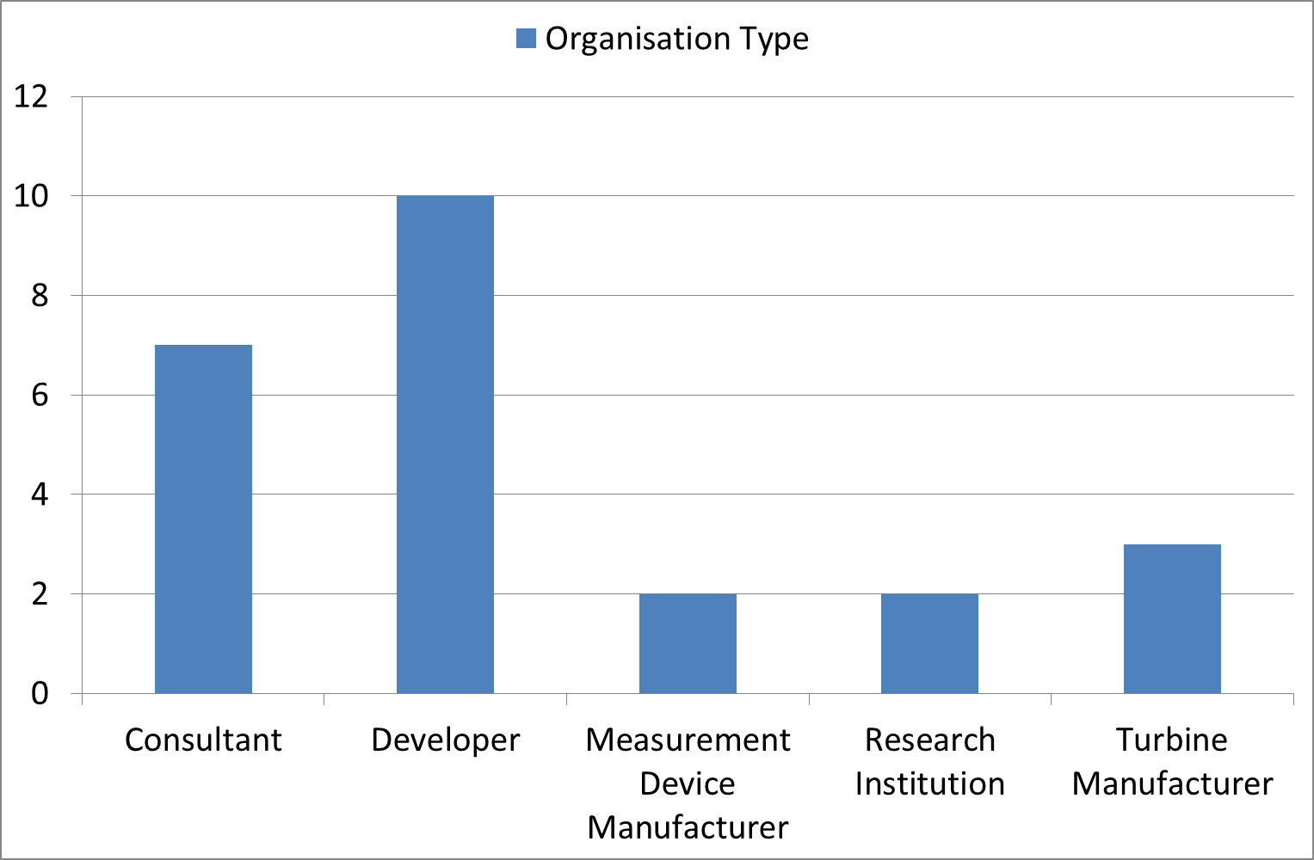
24 Responses in Total (from 16 distinct organisations)

Slide 3
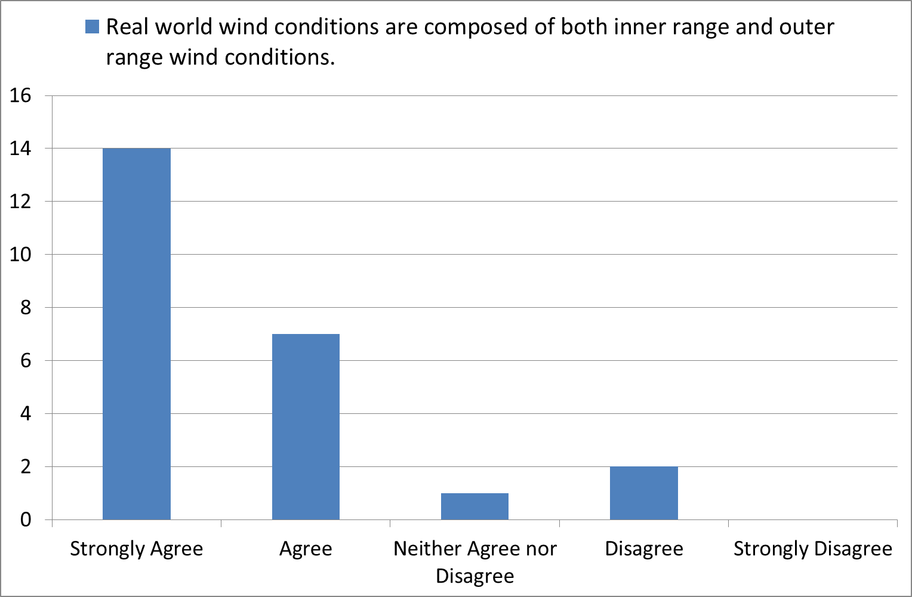
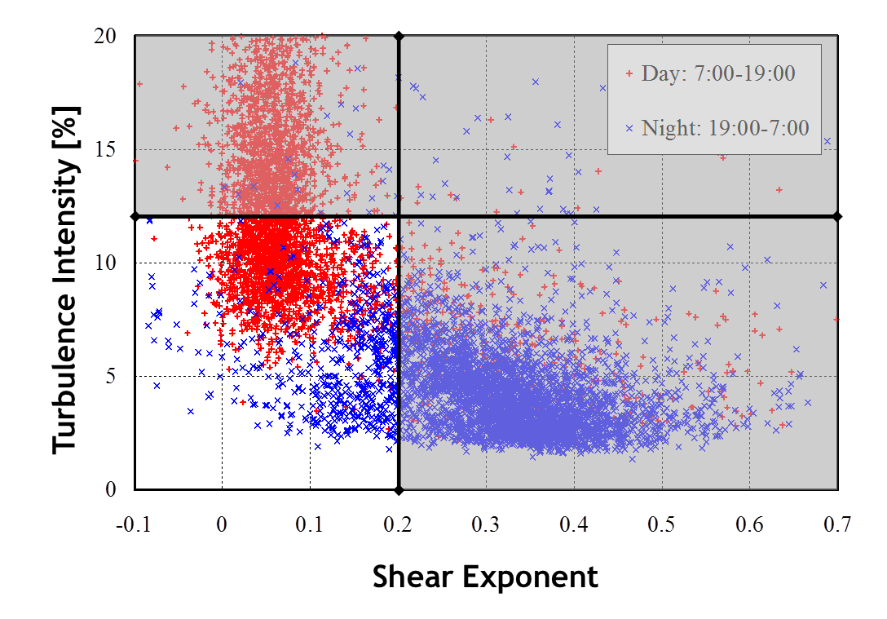
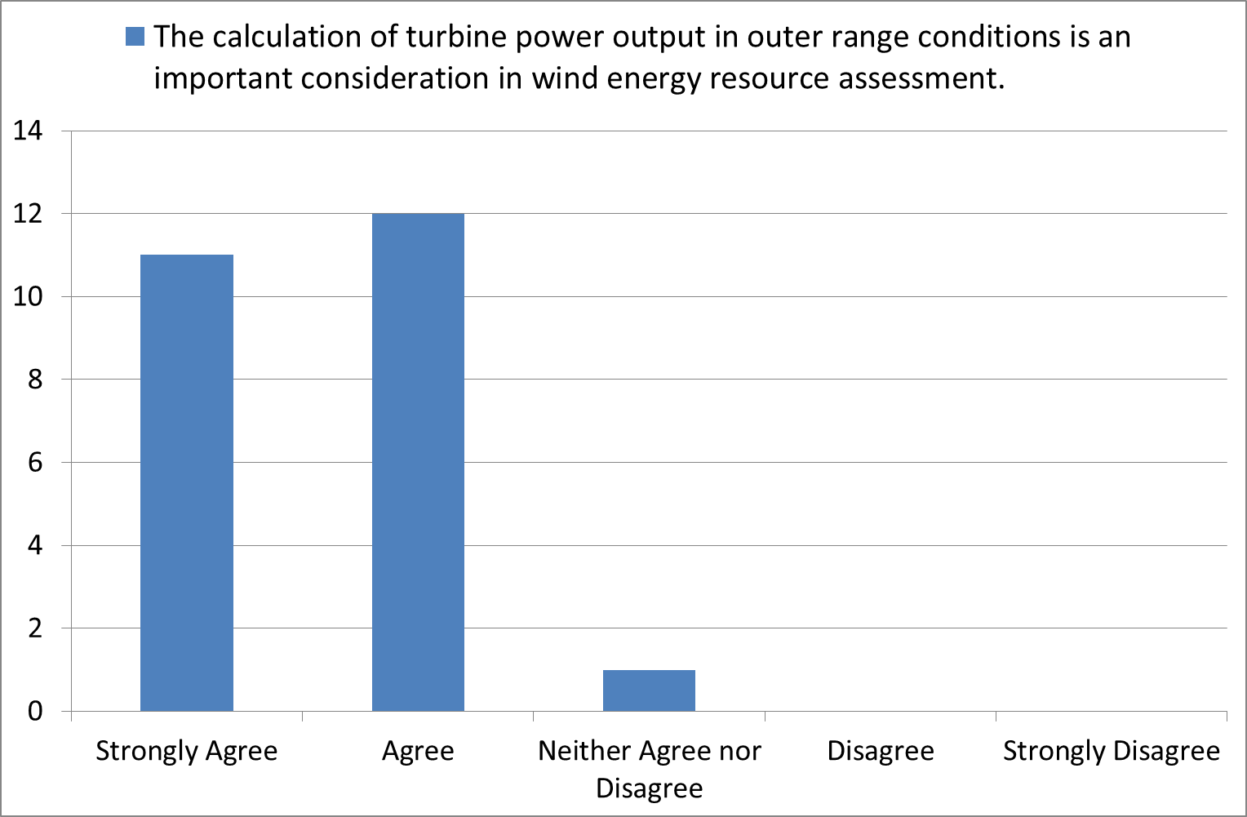
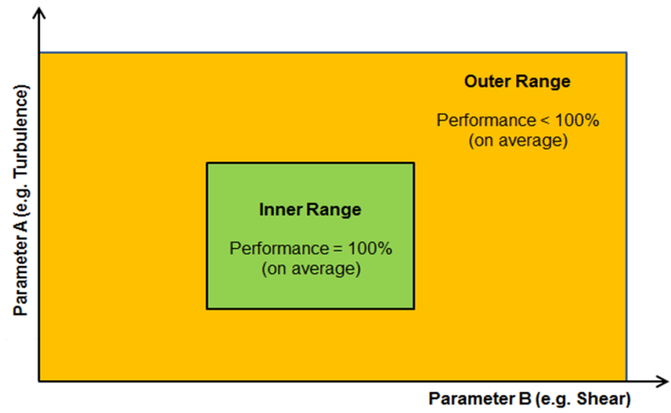

Slide 4
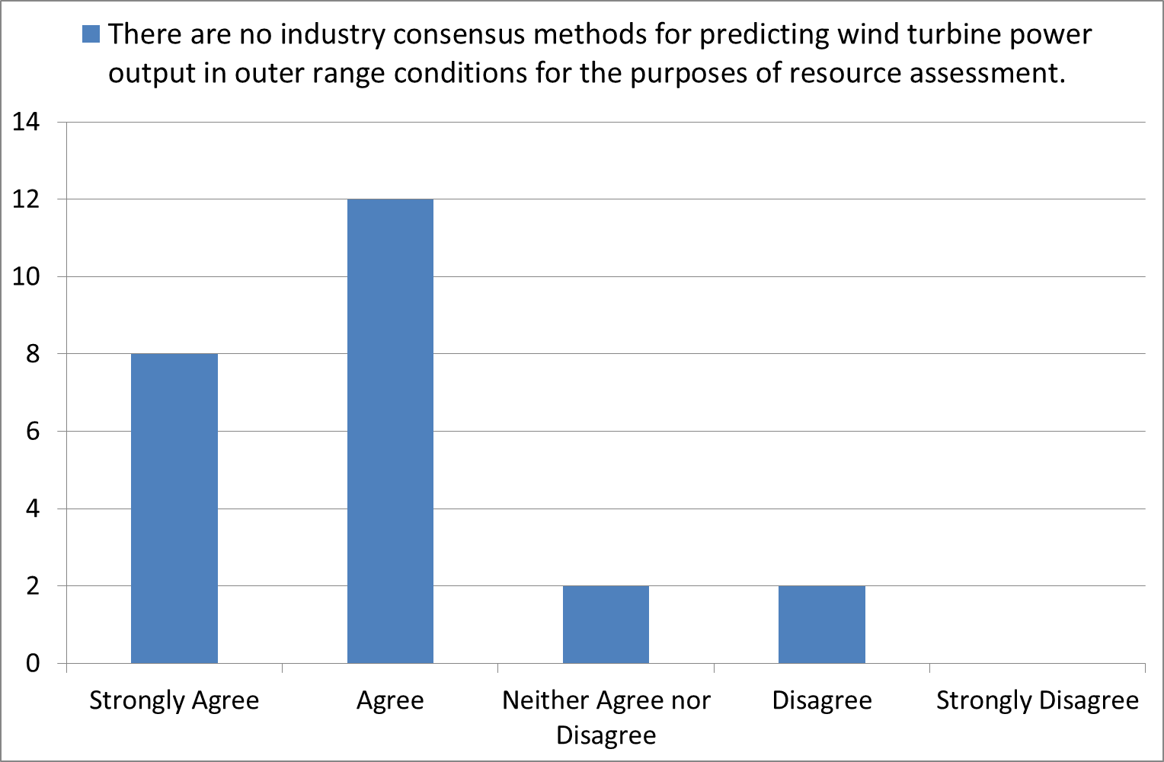
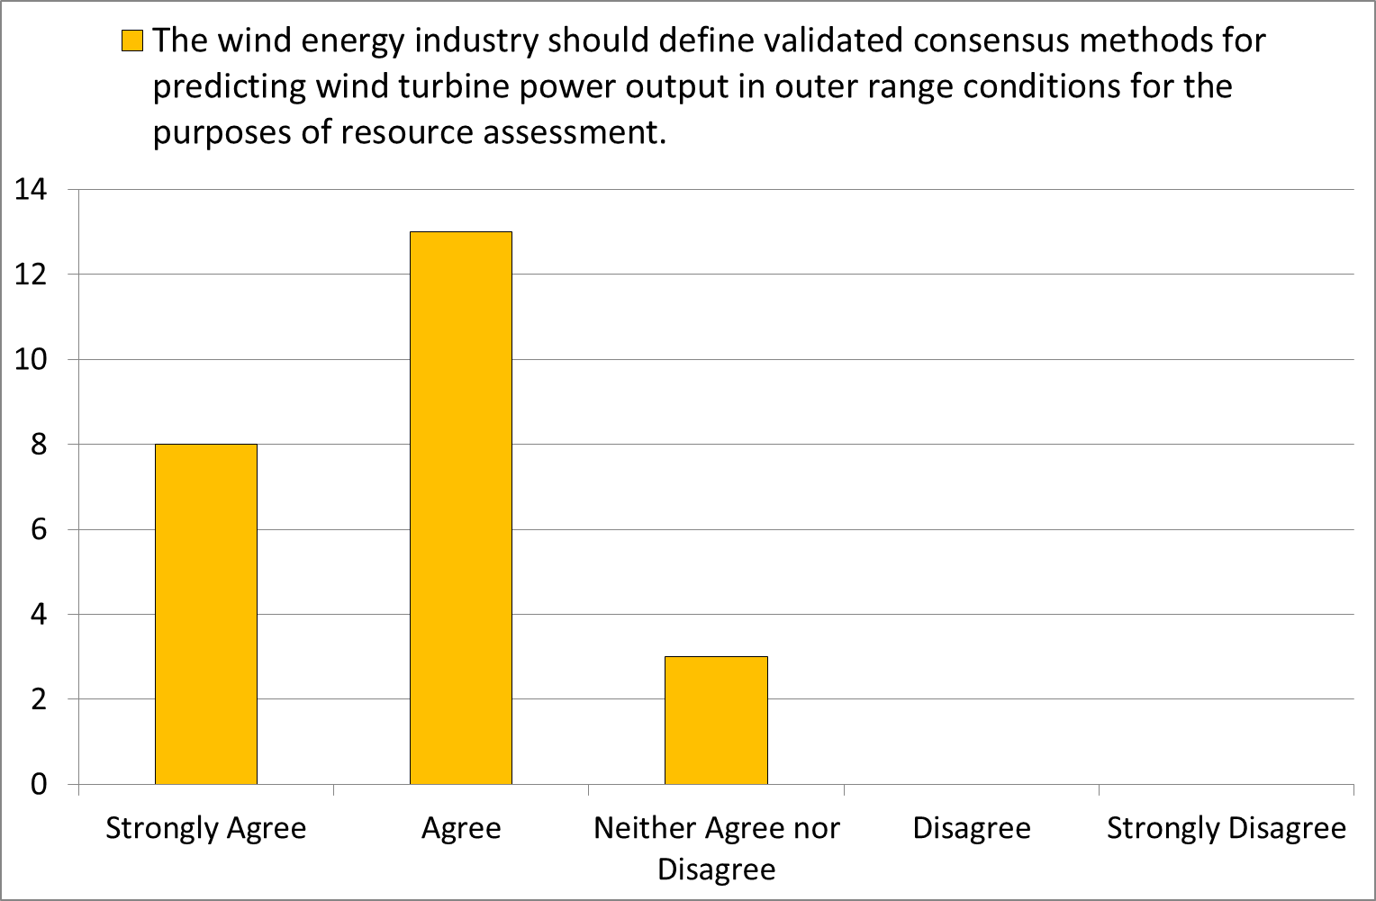
Comment from participant:
Real world power performance is consistently seen to vary from performance levels quoted by OEMs. A common cause for this is on-site wind flow conditions varying from those for which the sales/warranted power curve was calculated. Consultants have largely acknowledged this fact, and there are currently a range of power curve performance adjustment methods in use. These are largely proprietary and based on measured performance data. The range of methods applied and range of resulting performance adjustments may decrease lender confidence in pre-construction analysis methods, and should be addressed, with the co-operation of the OEMs.

Slide 5
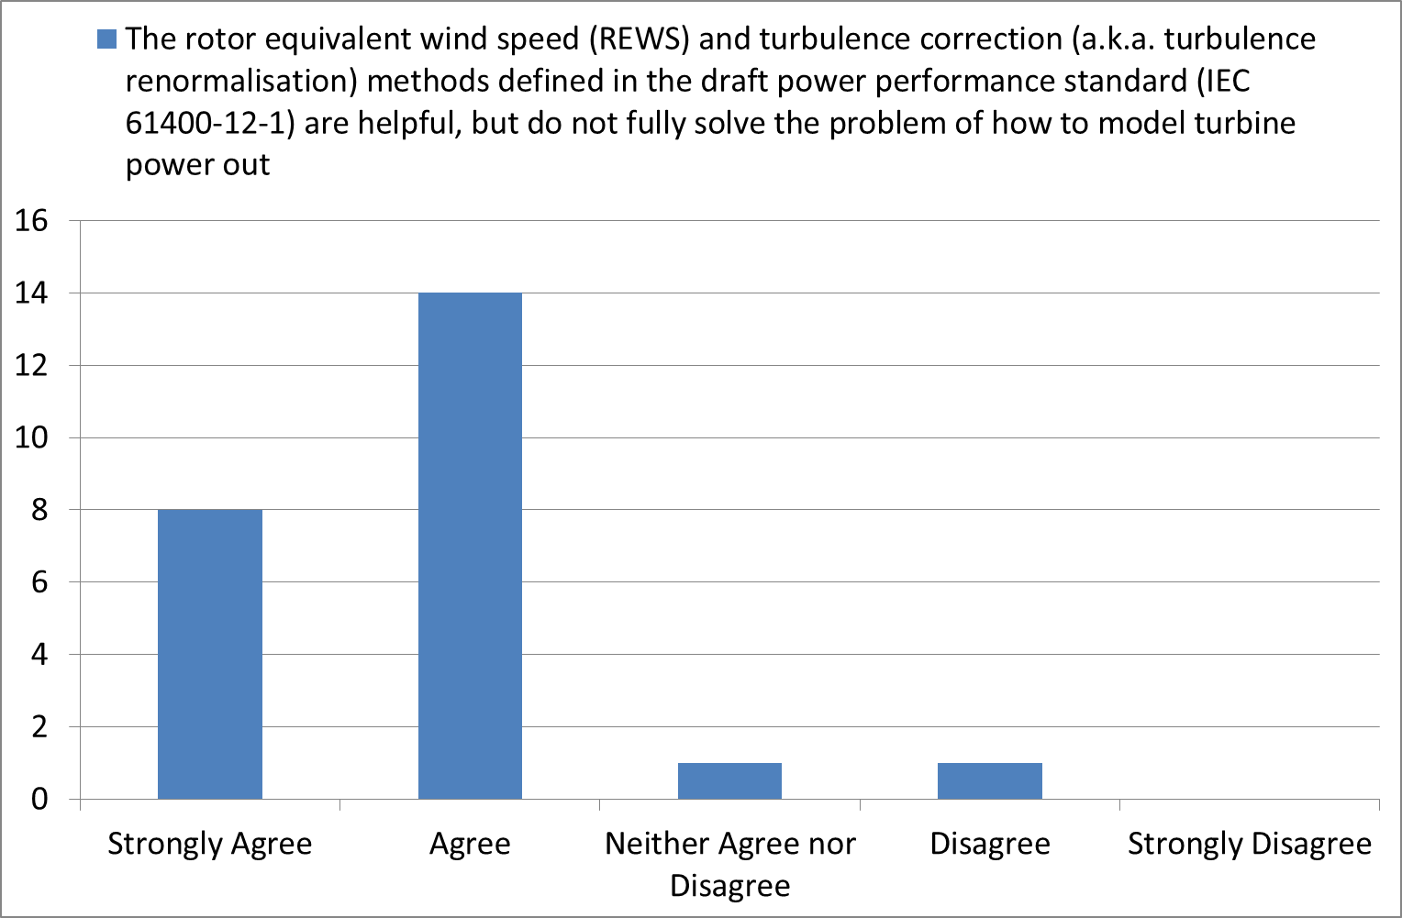
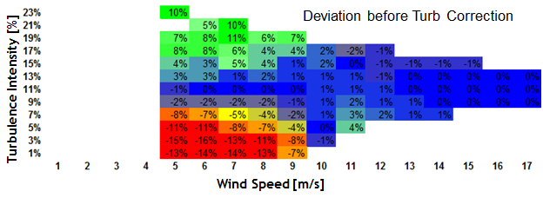
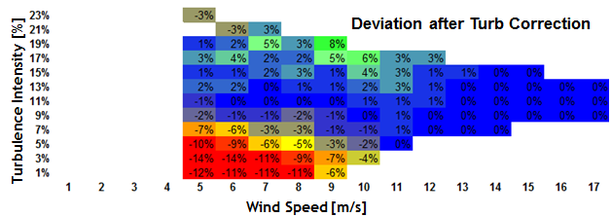
Comment from participant:
I think, it is not validated well whether the turbulence renormalisation + the rotor equivalent wind speed (including consideration of the tilt angle of the airflow) are really insufficient to explain observed turbulence effects on power curve low wind speeds. Of course, these methods represent approximations. It should be investigated whether these approximations together with there uncertainties are sufficient to treat the site (or climate) dependency of power curves.

Slide 6
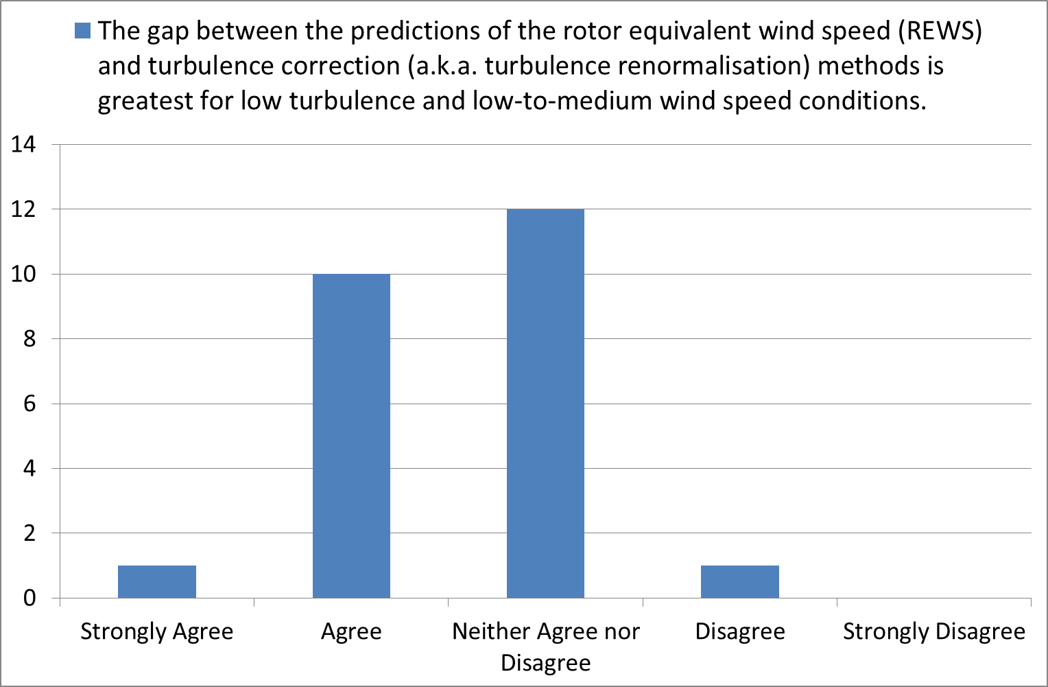
1
2
4
3

Slide 7
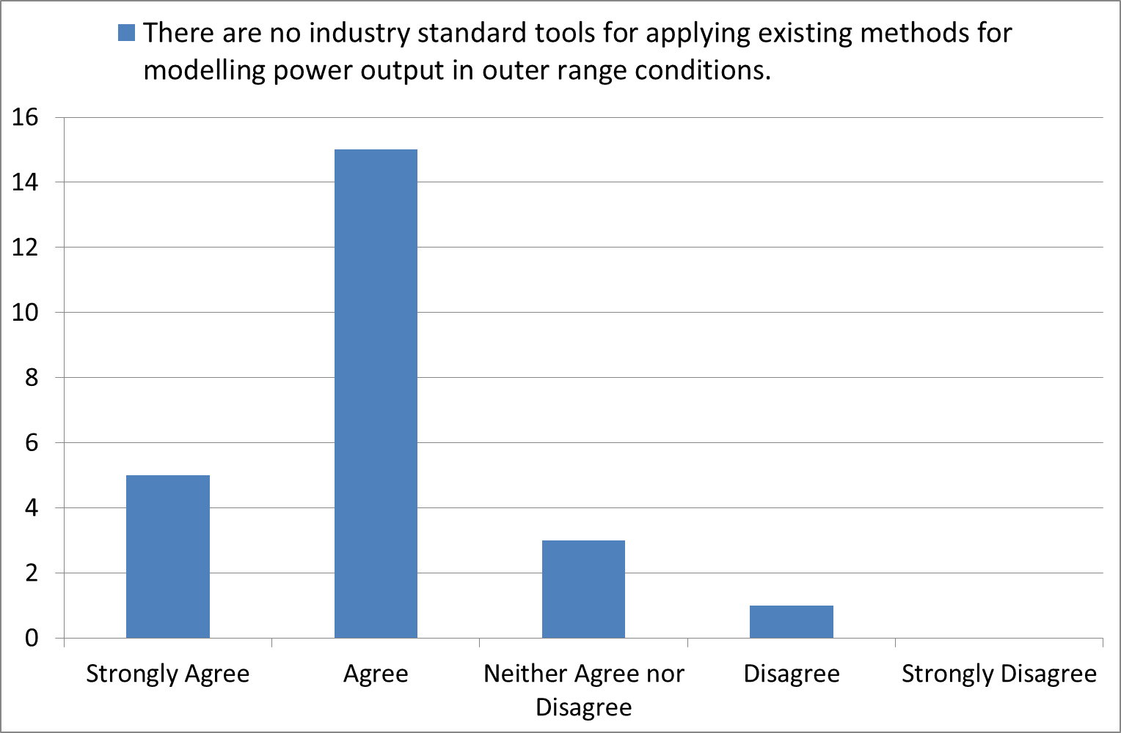
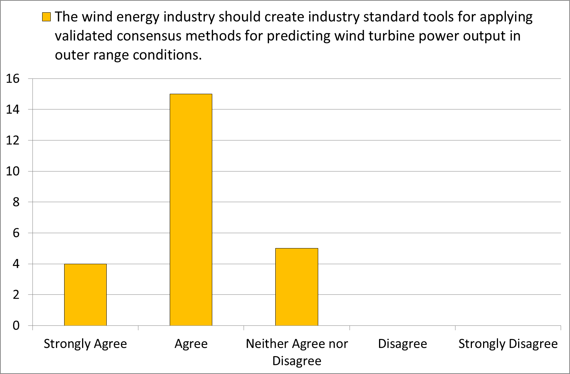
Note: this statement is not intended to imply that a single software should be used in favour to all others, but rather that one or many software should exists which adhere to standard benchmarks.

Slide 8
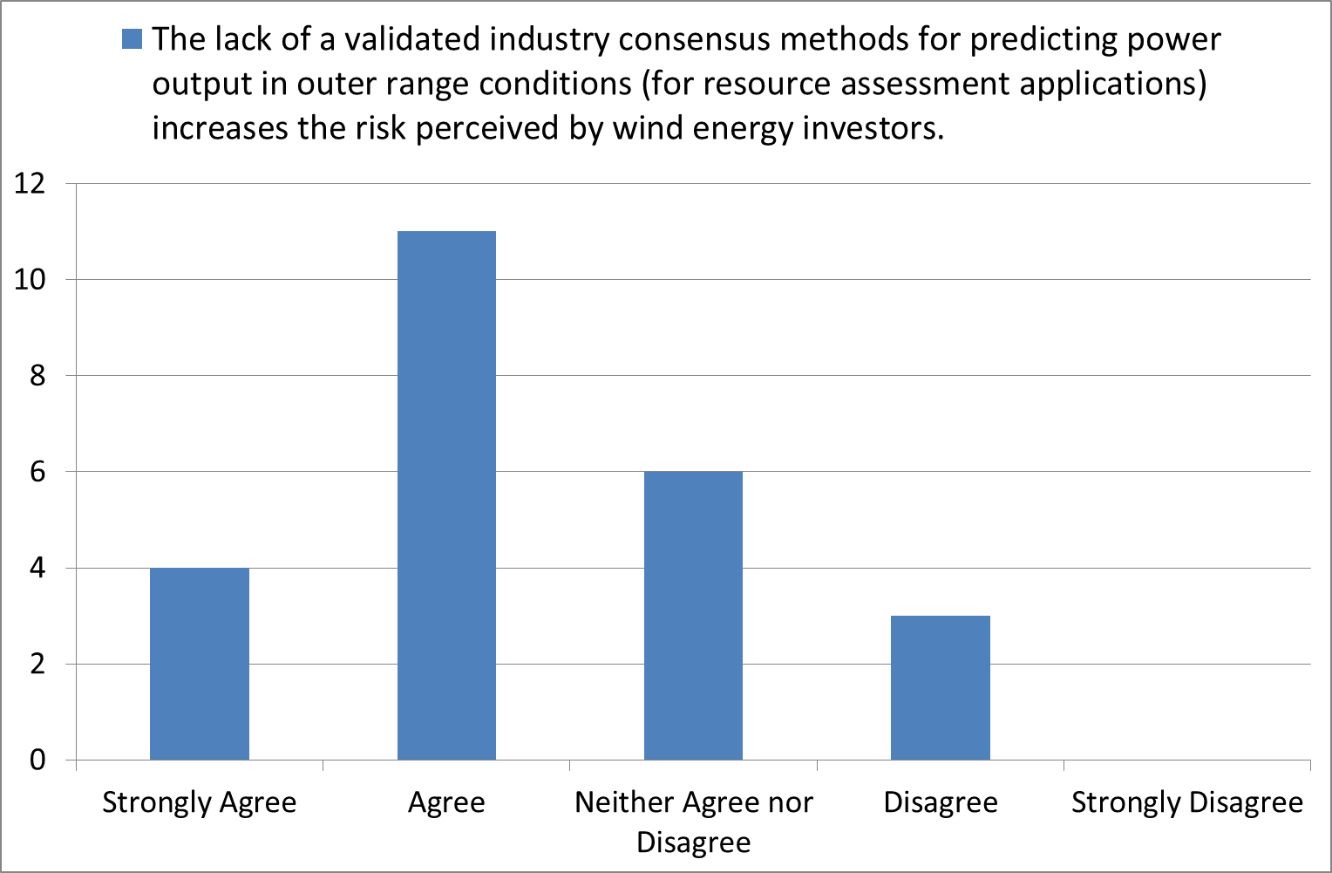

Slide 9
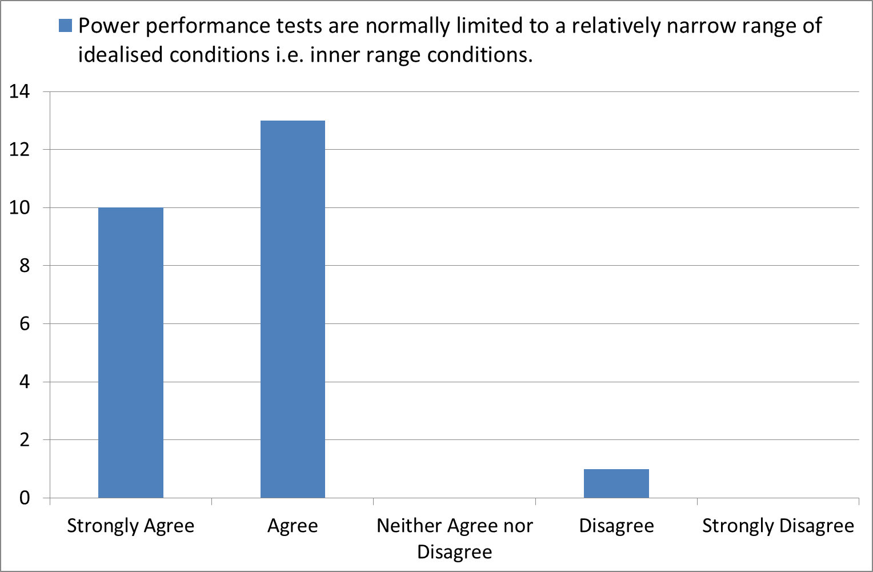
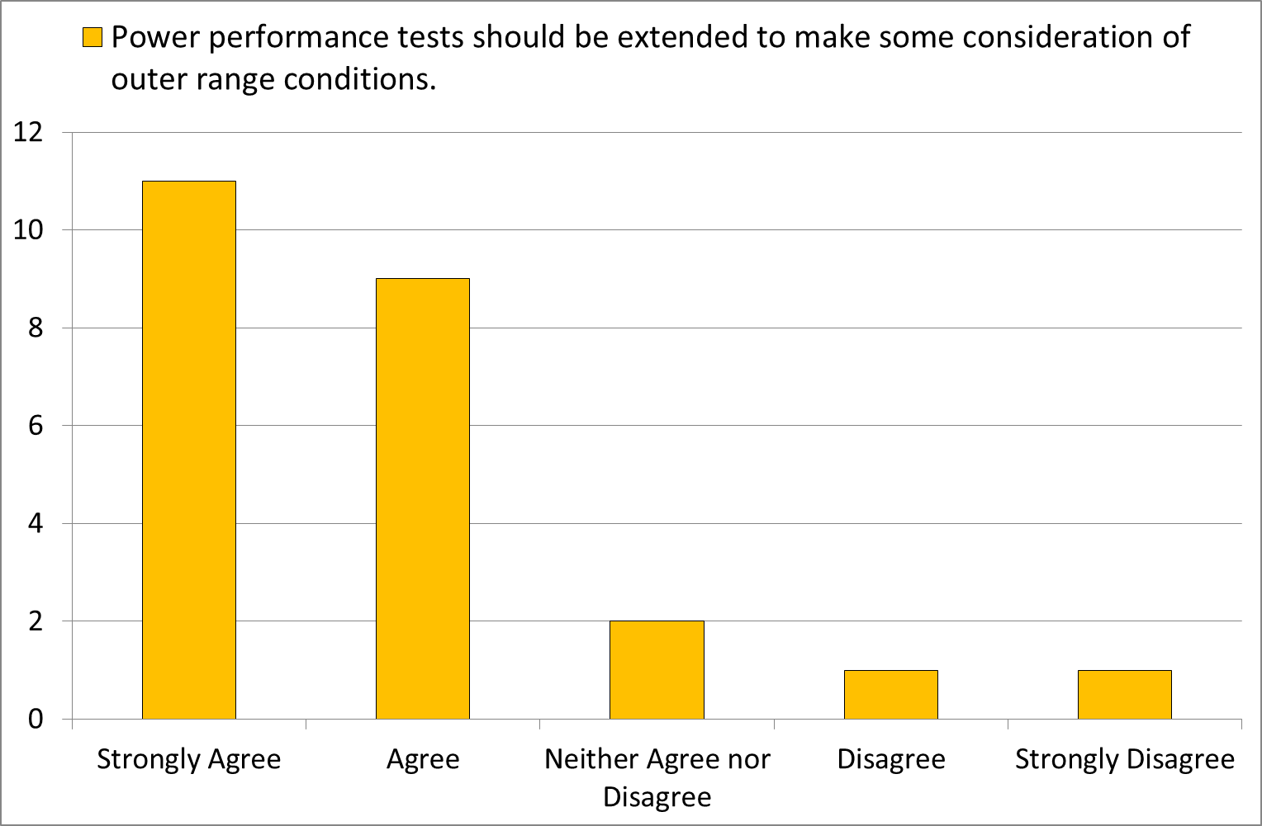

Slide 10
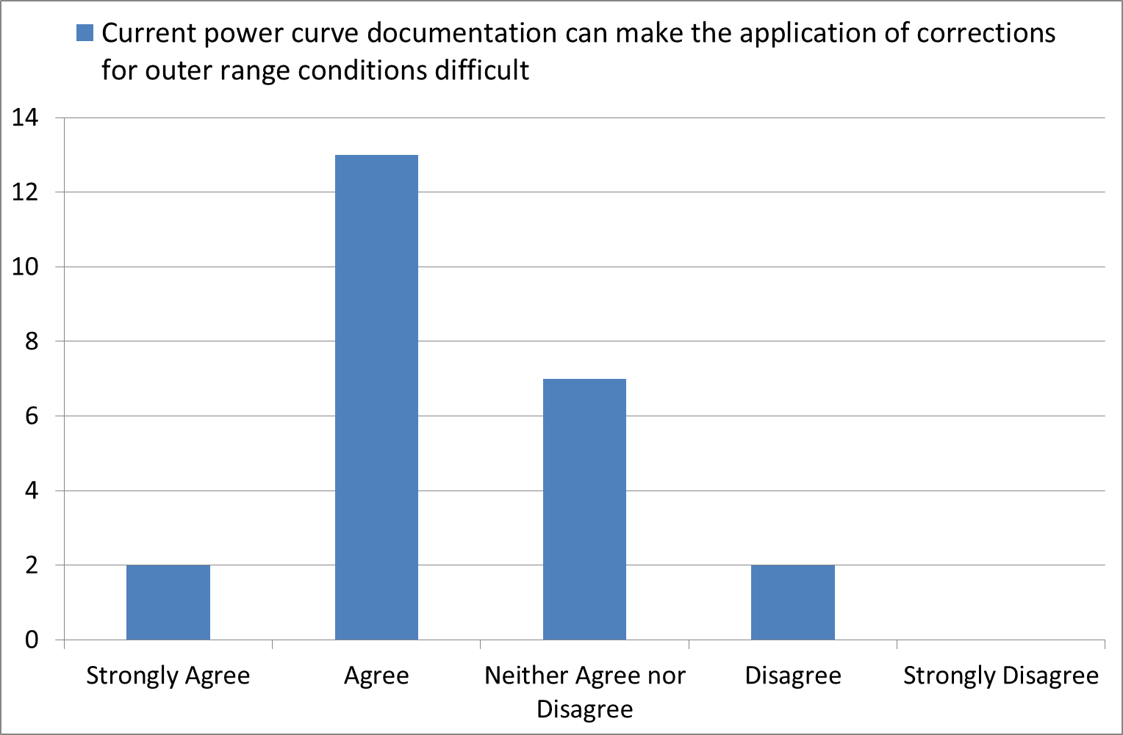
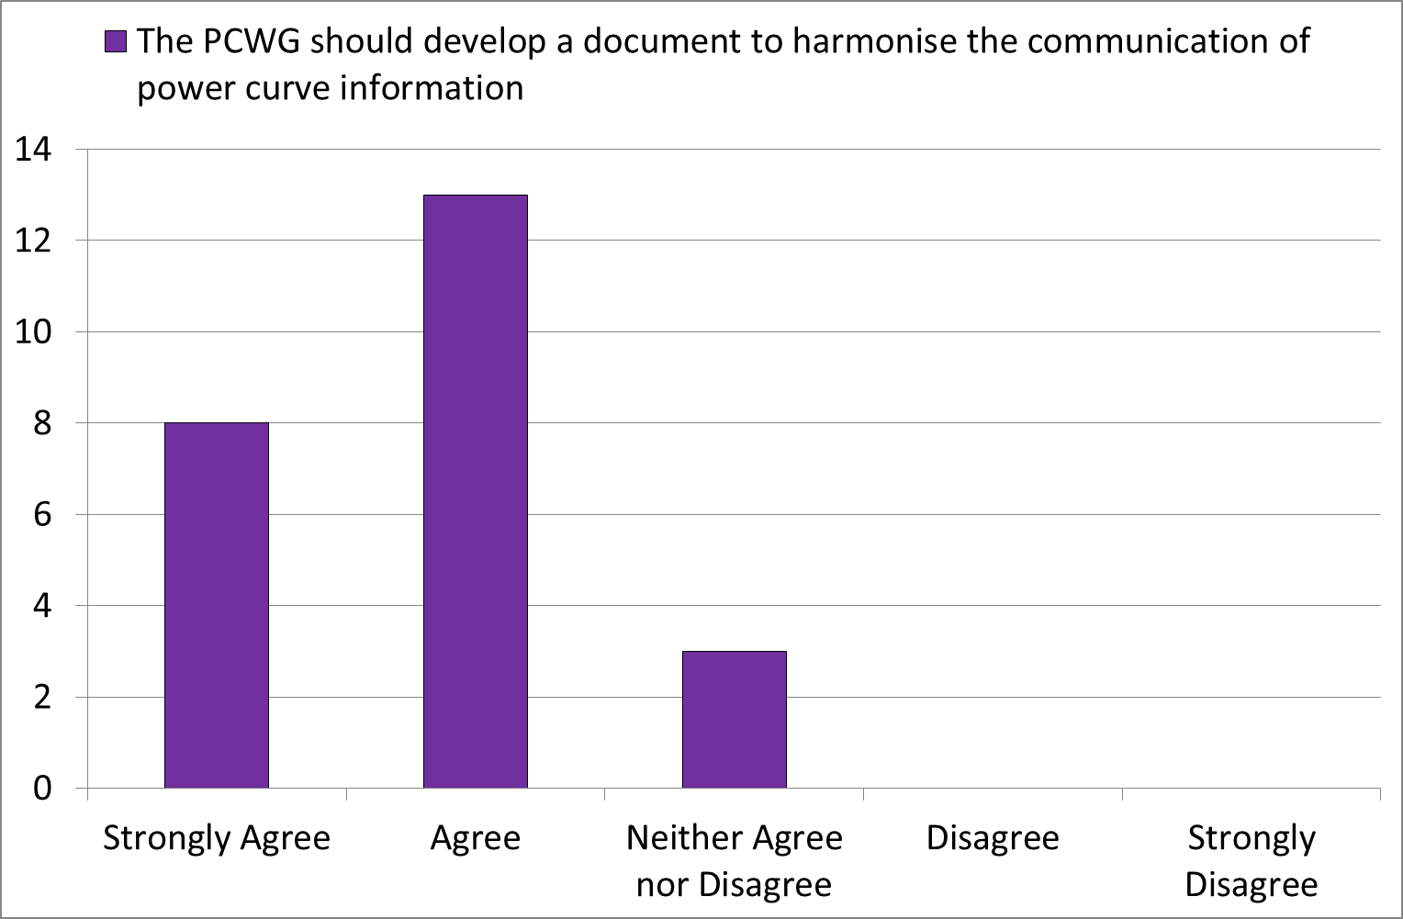
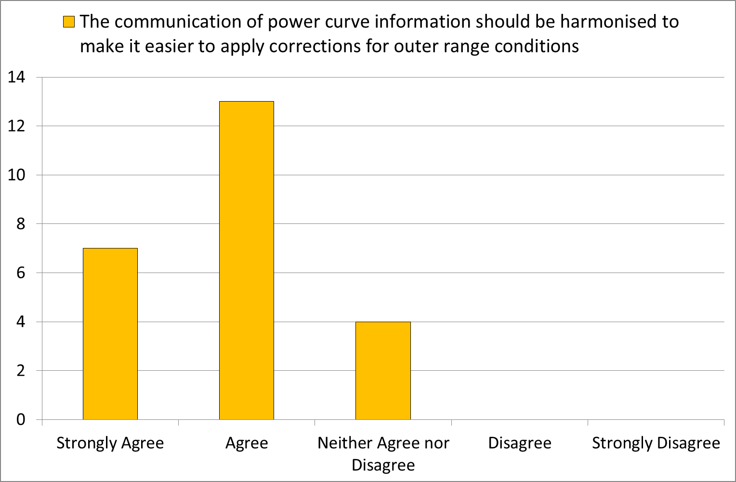

Slide 11
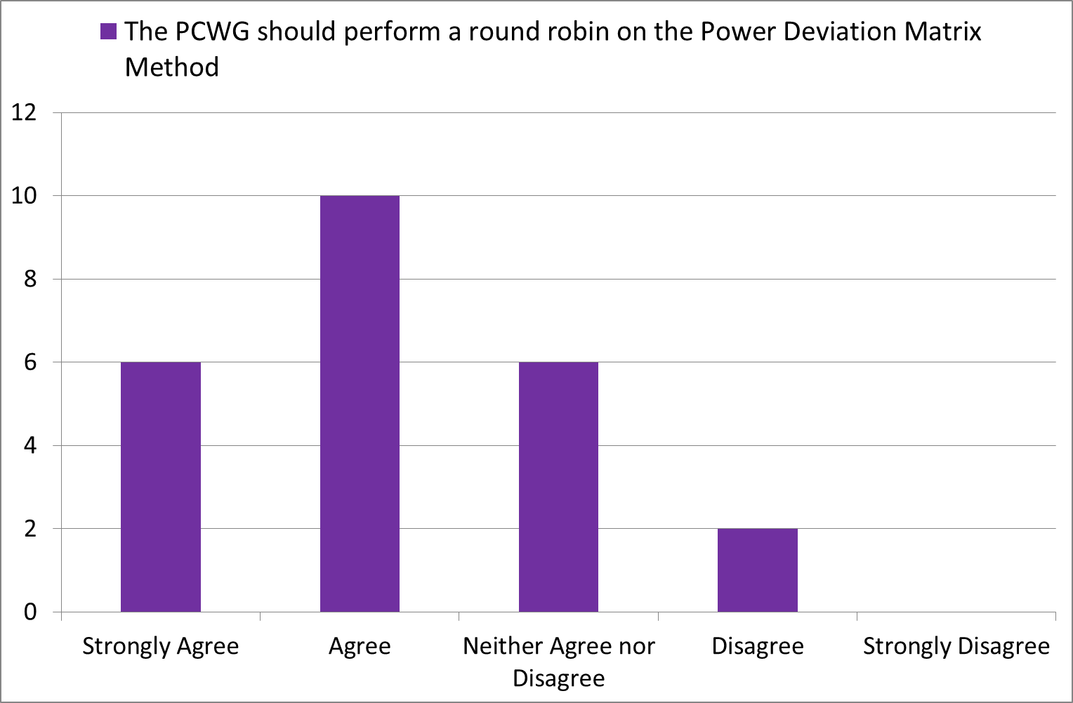
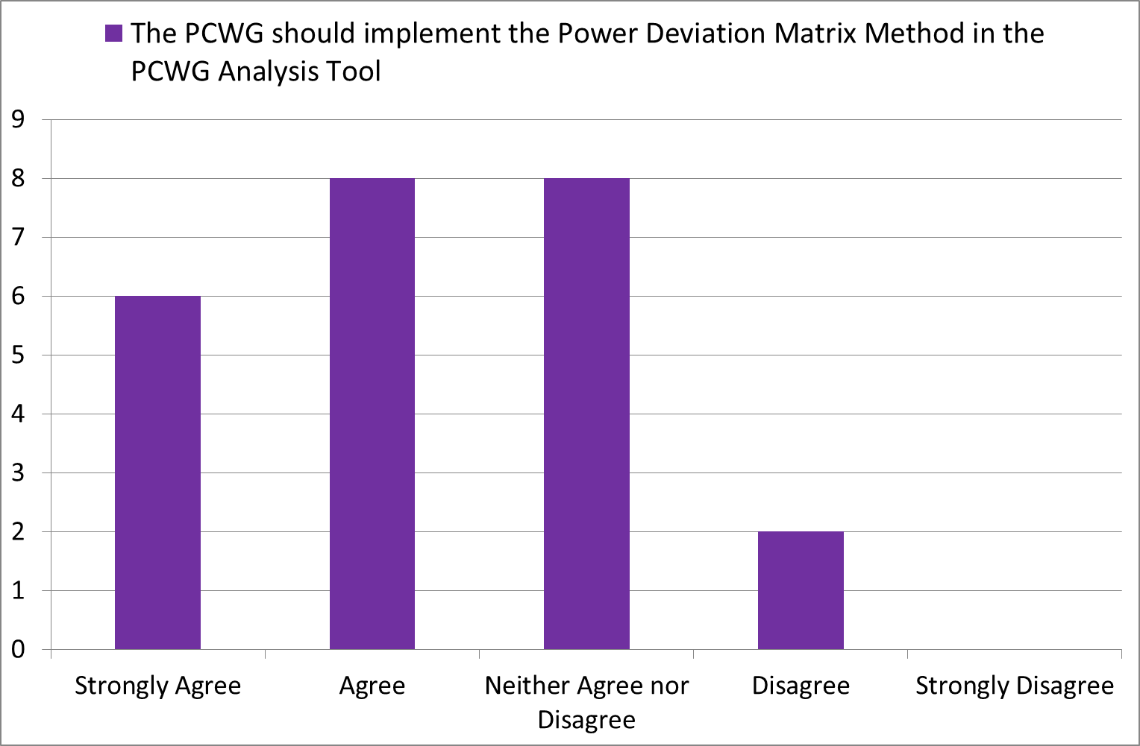

Slide 12
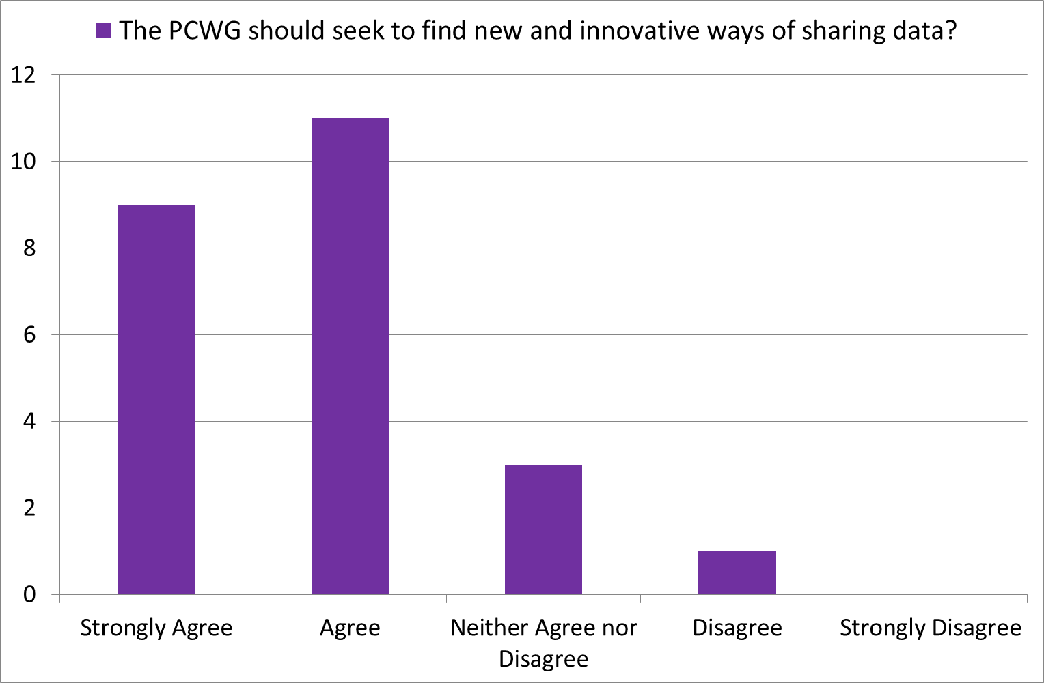
Comment from participant:
Data sharing may be the key to development of a robust turbine performance model. Through the PCWG, a huge amount of experience and analysis power can be brought to bear on the issue of real world power performance.

Slide 13
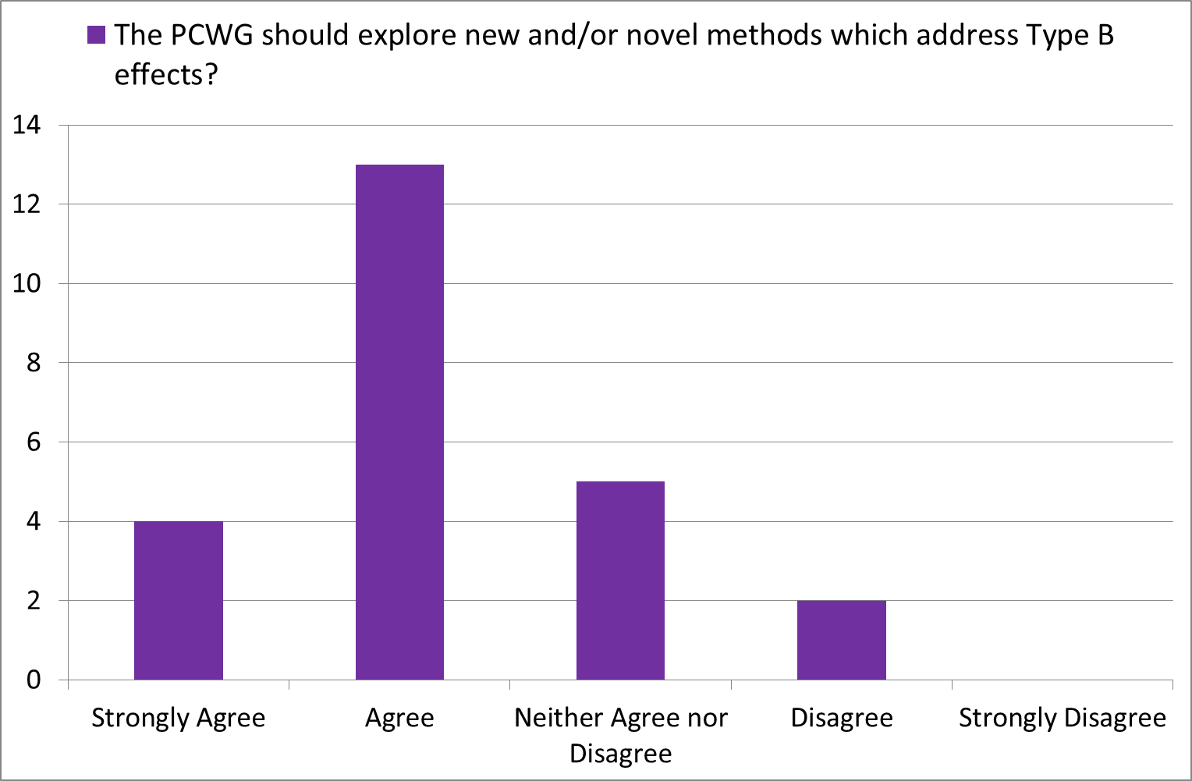

Slide 14
